Slide 1
UGE1577: Intellectual Property Rights
Unit 2 - REGISTRATION OF IPRs

Slide 2
Unit-2 Syllabus
Meaning and practical aspects of registration of
Copy Rights,
Trademarks,
Patents,
Geographical Indications,
Trade Secrets and
Industrial Design registration in India and Abroad.

Slide 3
2.1 Introduction
According to World Intellectual Property Organization (WIPO), intellectual property refers to creations of mind : inventions; literary and artistic works; and symbols, names and images used in commerce.
It can be divided into two categories :
Industrial property which includes patents for inventions, industrial designs, trademarks and geographical indications.
Copyright which covers literary works (e.g. novels, poems etc.), movies, music and/or any other artistic work
As an inventor, owner or author of such intellectual property you have rights, similar to in case of any other physical property.

Slide 4
2.1 Introduction - Patents
It prevents any other person or entity to use it without your permission along with giving due credit and even monetary compensation.
To legally enforce such right, you need to register your creation with the Office of Controller General of Patents, Designs and Trademarks under Ministry of Commerce and Industry, Government of India.
File in your application as soon as possible, as First-to-file rule is of great significance for registration of intellectual property.
If two or more applications are identical or similar only the first application will be given importance for registration.

Slide 5
2.1 Introduction
Patent implies a new product or process capable of industrial application. The product or process should be a new invention that has not been used before in the public domain.
Term for registered patents in India is 20 years.
Application for registration must be filed in the patent's office of relevant territorial jurisdiction by the inventor either alone or jointly or through assigned legal representative.
An important thing to understand is that these rights are territorial in nature and do not extend beyond the jurisdiction for which it is granted.

Slide 6
2.1 Introduction - Patents
If you want to reserve the intellectual property right in different countries, you can either directly file separate applications in the respective countries or file Patent Cooperation Treaty (PCT) application simultaneously with application in Form-1.
Along with the application (Form 1), you need to give in a provisional or complete specification of your invention (Form 2), details of any foreign filings for the same (Form 3), declaration that the product or process is your invention (Form 5), and Power of Attorney appointing a patent agent in Form 26, if any.
The process of registration, payment of fees, renewal is online and will require Digital Signature of the applicant

Slide 7
2.1 Introduction - Industrial design
According to WIPO, an industrial design refers to the ornamental or aesthetic aspects of an article.
A design may consist of 3-D features, such as the shape or surface of an article, or 2-D features such as patterns, lines or color.
Industrial designs are applied to a wide variety of industrial products and handicrafts.
The designs wing of the patents office under Government of India administers the registration process.
The process for registration in online - you need to create an account, fill in the application, digitally sign the form (Form 5 and 44) and make the payment

Slide 8
2.1 Introduction - Trademarks
Trademarks/Wordmarks are distinctive or unique sign or mark that identifies that a certain product or service belongs to or are provided by an individual or entity
A trademark provides recognition and familiarity among its consumers.
Regulation of trademarks in India is governed under Trademarks Act, 1999. This Act is in conformity with World Trade Organization recommendations and Trade-Related Aspects of Intellectual Property Rights (TRIPS) Agreement.
The Trademarks Department under the Office of Controller General of Patents, Designs & Trademarks administers trademarks in India.
The process of registration is online and is valid for 10 years, with an option to renew the same for another 10 years.

Slide 9
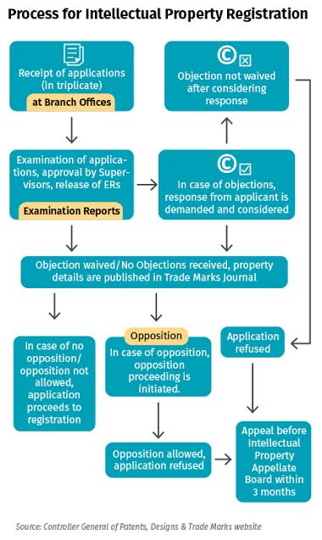

Slide 10
2.2 Meaning and Practical Aspects of Registrations of Copyrights
Copyright, is a bundle of rights, which grants protection to the unique expression of ideas.
Ideas per se cannot be protected;
It is the expression of ideas in a material medium that is the subject matter of copyright protection.
Copyright is a negative right and the owner of a copyright gets the right to prevent others from copying his work without his consent towards a commercial end.
Copyright in India is recognized virtually worldwide under the Berne Convention and the applicable law of its member nation
Registering your work with the Registrar of Copyright Office is basically a copyright protection insurance policy.
Copyright protection arises automatically the moment the author fixes the work in a tangible form (i.e. when a writer writes her story), without the author having to do anything.

Slide 11
2.2 Meaning and Practical Aspects of Registrations of Copyrights
Copyright, unlike the other intellectual property rights does not require any formal procedures as such and affords protection during the lifetime of the author and sixty-years thereafter
List of creative works protected by the copyright law in India are :
Literary work which includes computer program and computer databases apart from book.
Sound recording or audio recorded files which could include songs, dialogues recorded Etc.
Cinematograph film includes films, videos, cartoon films. It is advisable to include creative rights in the various agreements between parties in the initial stage itself.
Artistic work including a painting, a sculpture, a drawing such as a map, chart or diagram, an engraving, a photograph, architecture/ artistic craftsmanship and dramatic work.
Musical work meaning staff notations and written music.

Slide 12
2.2.2 Things that cannot be Copyrighted in India
Ideas, methods, or systems
Commonly known information
Choreographic works
Names, Titles, Short phrases, or Expressions
Fashion

Slide 13
2.2.3 Necessity of Copyright Registration
The object of copyright law is to encourage authors composers and artists to create original works by rewarding them with the exclusive right for a limited period to reproduce the works for the benefit of the public.
On the expiry of the term copyright the works belong to the public domain and anyone may reproduce them without permission
The exclusive right given to the author is a negative right a right to prevent others from copying or reproducing the work
Copyright like patent right, is a monopoly restraining the public from doing that which, apart from the monopoly, it would be perfectly lawful for them to do
Copyrights operates against unauthorized copying, the taking of another's creation, without paying for it.

Slide 14
2.2.3 Necessity of Copyright Registration
Copyright is essentially a creation of statute, the copyright act makes it clear that no person shall be entitled to copyright or any similar rights
Copyright registration of creative work protects your creativity from being stolen or duplicated and gives you a confirmed legal right over your creation.
Copyright registration gives your creative work a legal status, thereby making it an intellectual property, giving you exclusive legal right over your creation.
Copyright registration guarantees speedy justice.
Copyright registration is necessary to obtain legal right over your creative work
Copyright registration establishes a public record of your copyright and puts everyone in the world on notice that you have sought and claim copyright protection under the copyright laws.

Slide 15
2.2.3 Necessity of Copyright Registration
You cannot sue anyone for copyright infringement until you have filed for copyright protection with the Registrar of Copyright Office.
If the registration of your work is done within five years from its creation, it is considered Prima Facie Evidence in court.
Prima facie evidence means that if you ever went to court, proof of the copyright registration with the Registrar of Copyright Office would be sufficient evidence of your ownership of the copyrighted material
The only way for another party to win would be for them to present evidence showing :
That they had a pre-existing copyright claim to the work.
That you permitted them to use your work.
That you didn't actually create the work.
That you stole it from them

Slide 16
2.2.3 Necessity of Copyright Registration
You cannot sue anyone for copyright infringement until you have filed for copyright protection with the Registrar of Copyright Office.
If the registration of your work is done within five years from its creation, it is considered Prima Facie Evidence in court.
Prima facie evidence means that if you ever went to court, proof of the copyright registration with the Registrar of Copyright Office would be sufficient evidence of your ownership of the copyrighted material
The only way for another party to win would be for them to present evidence showing :
That they had a pre-existing copyright claim to the work.
That you permitted them to use your work.
That you didn't actually create the work.
That you stole it from them

Slide 17
2.2.4 Form of Register of Copyrights
The register of copyrights as per the Act to be kept both in physical and electronic form in six parts, namely -
Part I Literary works other than computer programs, tables and compilations including computer databases and dramatic work
Part II Musical works
Part III Artistic works
Part IV Cinematograph films
Part V Sound recordings
Part VI Computer programs, tables and compilations including computer databases
As specified in Form XIII of the register of copyrights shall contain these particulars:
A) Application for registration of copyright :
B) Rectification and correction of entries in the register of copyrights
C) Copyright Indexes
D) Inspection of the Register of Copyrights and Indexes
E) Copies and extracts of the Register of Copyrights and Indexes

Slide 18
2.2.4 Form of Register of Copyrights
A) Application for registration of copyright :
All Application for registration of copyright shall be made in Form XIV and in Form XV every application for registration of changes in the particulars of copyright entered in the register of copyright shall be made.
Each application has to be separately submitted and must be accompanied by the fee specified in the second schedule in this regard.
The application must be signed by the applicant only. i.e. An author or owner of right. If the application is submitted by the owner of copyright, than no objection certificate issued by the author is mandatory
An application for registration of an unpublished work must be submitted along with two copies of the work.
Every application for registration of a computer programme shall accompanied by the source and object code.
Registration application can be filed in the Copyright Office in person or by post or by online filing facility as provided on the website of the Copyright Office.
The registrar of copyrights shall give an opportunity of hearing before rejecting any application filed for registration of any work.

Slide 19
2.2.4 Form of Register of Copyrights
B) Rectification and correction of entries in the register of copyrights
For the entries specified in section 49 the registrar of copyrights may, either suo motu or on application of any interested person amend, or alter the register of copyrights, after giving, wherever practicable, to the person affected by such amendment or alteration, and communicate to such person the amendment or alteration so made
The Registrar of Copyrights shall rectify the entries made in the Register of Copyrights after an order is being passed by the Board on an application made by Registrar of the Copyrights in this behalf under section 50.

Slide 20
2.2.4 Form of Register of Copyrights
C) Copyright Indexes
Copyright Office keeps the following Indexes both in physical and electronic form for each and
every part of the Register of Copyrights, namely;
i) A general Author Index;
ii) A general Title Index
iii) An Author Index of works in each language; and
iv) A Title Index of works in each language
Every Index shall be arranged alphabetically in the form of cards.

Slide 21
2.2.4 Form of Register of Copyrights
D) Inspection of the Register of Copyrights and Indexes :
The Register of Copyrights and indexes thereof shall at all reasonable time be open to inspection any person in such manner and subject to such conditions as the Registrar of Copyrights may specify.
The online search or inspection of the Register of Copyrights and indexes can be utilised by making online payment of fee as specified in the Schedule.
E) Copies and extracts of the Register of Copyrights and Indexes :
Any one shall be entitled to take copies of, or make extracts from, the Register of Copyrights or Indexes on payment of the fee as specified in the Second Schedule subject to supervision as the Registrar of Copyrights may arrange.
To furnish a certified copy of entries made in the Register of Copyrights and Indexes thereof, An application to The Registrar of Copyrights has to be made along with payment of the fee specified in the Second Schedule

Slide 22
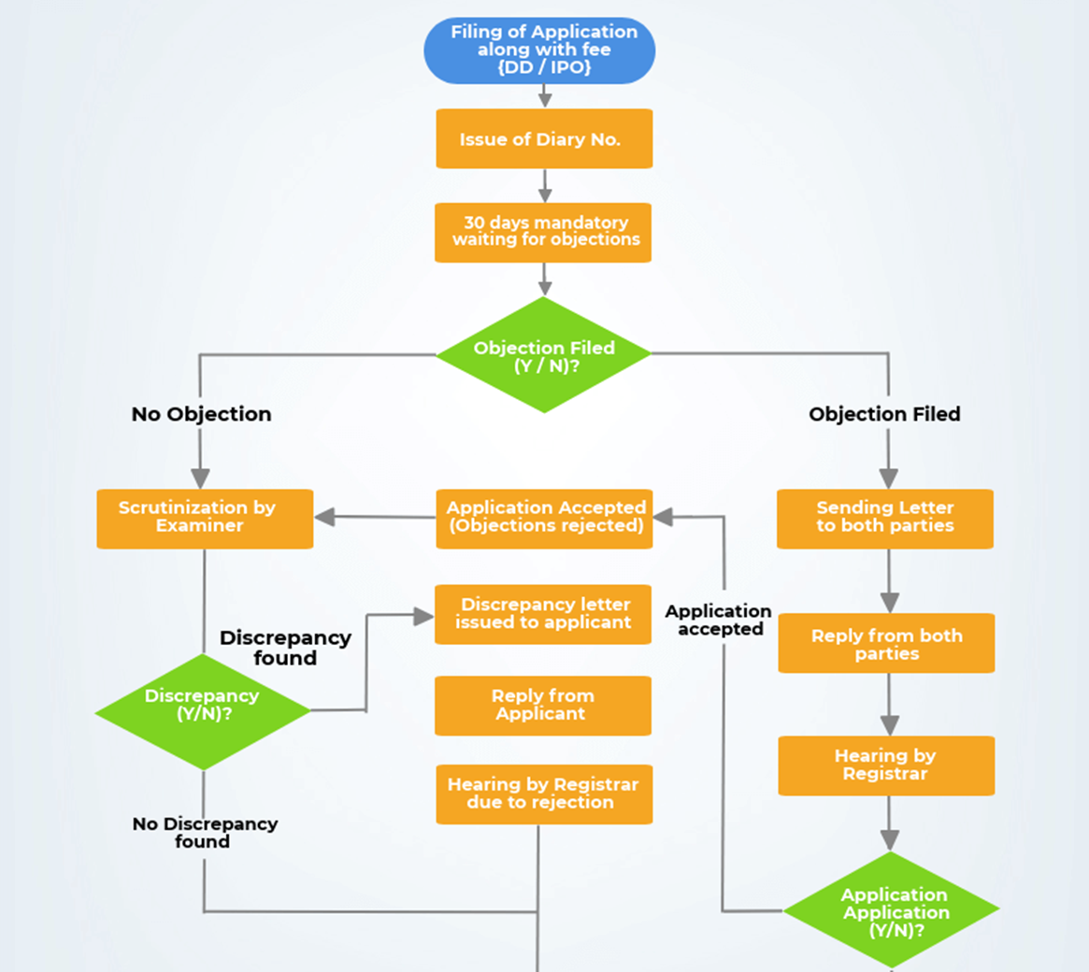
2.2.5 Steps Involved in Making a Registration of Copyright

Slide 23
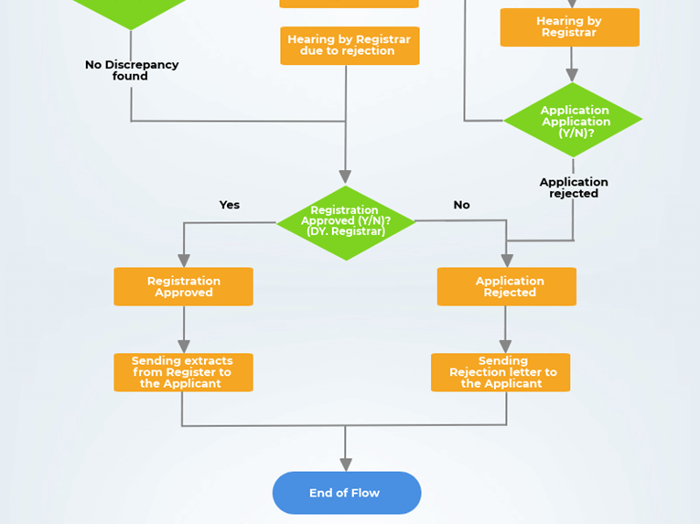

Slide 24
2.2.5 Steps Involved in Making a Registration of Copyright
Application in triplicate with prescribed fee.
Application to serve notice of his application to every person who has any interest in the subject-matter.
If the Registrar receives no objection for registration within 30 days of receipt of application by him, he shall, is satisfied about the correctness of particulars, enter such particulars in objection, he may, after holding such inquiry as he deems fit, enter such particulars of the work in the Register of Copy rights which he considered proper.
Registrar then sends copies of the entries made in the Register to the parties concerned.
Appeal : Any person aggrieved by the decision or order of Registrar of Copyright, may, within three months from the date of the order or decision, appeal to the Copyright Boar

Slide 25
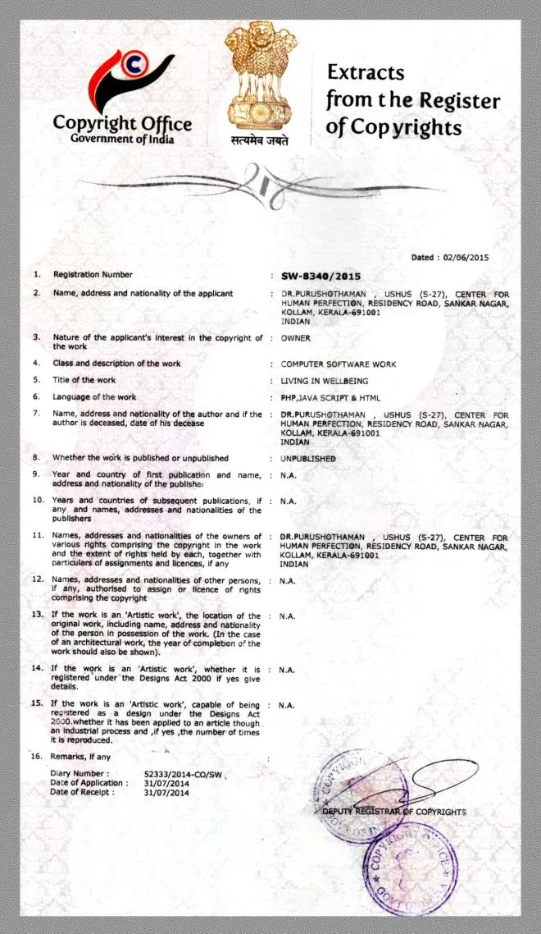

Slide 26
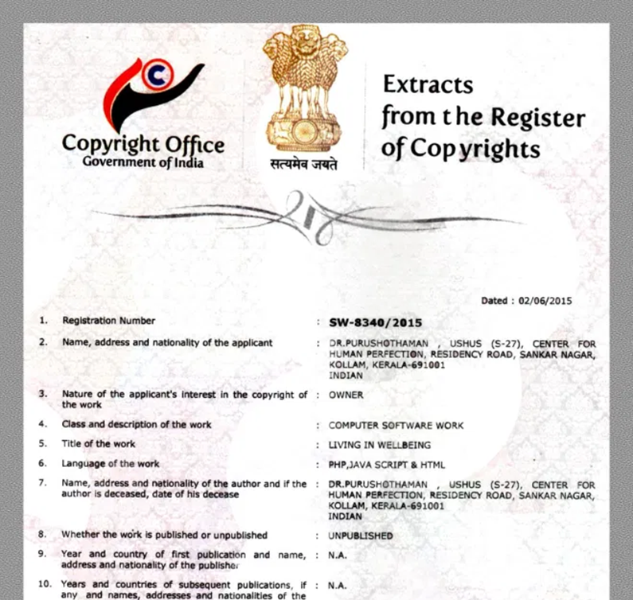

Slide 27
Scope and Extent of Copyright Registration
These Days the Copyright Law has become Global - India being a member of Berne Convention has Made the validity of your certificate to over 177 countries.

Slide 28
2.3 Meaning and Practical Aspects of Registrations of Trademarks
2.3.1 Introduction
A trademark is a sign capable of distinguishing the goods or services of one enterprise from those of other enterprises.
Trademarks are protected by intellectual property rights. Popularly known word "Brand Name" is referred as "Trademark" in legal terms.
A Trademark means any symbol, word, name, device, numerals or combination of both, which can be represented graphically can be registered as trademark.
A trademark is unique symbol which distinguishes your goods or services from others. The trademark which is registered for services are known as the service marks.

Slide 29
2.3 Meaning and Practical Aspects of Registrations of Trademarks
2.3.1 Introduction
At the national/regional level, trademark protection can be obtained through registration, by filing an application for registration with the national/regional trademark office and paying the required fees.
At the international level, you have two options: Either you can file a trademark application with the trademark office of each country in which you are seeking protection, or you can use WIPO's Madrid System.
In principle, a trademark registration will confer an exclusive right to the use of the registered trademark.
The term of trademark registration can vary but is usually ten years. It can be renewed indefinitely on payment of additional fees.
Trademark rights are private rights and protection is enforced through court orders

Slide 30
2.3 Meaning and Practical Aspects of Registrations of Trademarks
2.3.1 Introduction
Kinds of trademark can be registered :
A word or a combination of words, letters, and numerals can perfectly constitute a trademark.
But trademarks may also consist of drawings, symbols, three-dimensional features such as the shape and packaging of goods, non-visible signs such as sounds or fragrances, or color shades used as distinguishing features

Slide 31
2.3 Meaning and Practical Aspects of Registrations of Trademarks
2.3.2 Advantages of Trademark Registration
Exclusive rights: The owner of Registered Trademark enjoys exclusive right over the trademark. The owner can use the same for all the products falling under the class(es) applied.
Builds trust and goodwill: The established quality of your product and services are known by everyone through the trademark and which establishes trust and goodwill among the customers in market. It helps in creating permanent customers who are loyal and always opt for the same brand
Differentiates product: It makes easy for customers to find your products. It makes your product and identity of products different from that of the existing and foreseen competitors and acts as efficient commercial tool.

Slide 32
2.3 Meaning and Practical Aspects of Registrations of Trademarks
2.3.2 Advantages of Trademark Registration
Recognition to product's quality : It gives recognition to the quality of the product. Customers attach the product's quality with the brand name and this image is created in the market about the quality of a particular brand which helps in attracting new customers as they can
Creation of asset : Registration of Trademark creates an intangible asset i.e. Intellectual Property for an organization. Registered trademark is a right created which can be sold, assigned, franchised or commercially contracted. Also, the Trademark is an intangible asset which gives the advantage to the organization
Use of ® symbol : Once the trademark is registered you can use the ® symbol on your logo stating that it is a registered trademark and no one can use the same trademark. It is exclusive of all types of usages as well as rights. If someone else use the trademark then you can also sue the party if the trademark is registered

Slide 33
2.3 Meaning and Practical Aspects of Registrations of Trademarks
2.3.2 Advantages of Trademark Registration
Protection against infringement : No competitor or other person can use the wordmark or logo registered by you under trademark.
Protection for 10 Years at low cost : Online Trademark registration is done on a very low maintainability cost. Once you register the trademark you have to just pay the maintenance cost and renewal cost which is after 10 years of registering the trademark. It is cost efficient and helps your company create an unique image
Global trademark registration : If one wants to register the trademark in countries other than India, the trademark registered in India can be used as basis of registration there
Attract human resources : Young minds aspire to join big Brands as it acts as a magnate. It inspires the positive image of the organisation and thus candidates are attracted towards them easily. This reduces the cost towards hiring and related activities.

Slide 34
2.3.3 Conditions when Trademark Rights can be Lost
Trademark rights can also be lost through improper licensing or assignment :Where the use of a trademark is licensed (for example, to a franchisee) without adequate quality control or supervision by the trademark owner, that trademark will be canceled.
Trademark rights can also be lost through genericity. Sometimes, trademarks that are originally distinctive can become generic over time, thereby losing its trademark protection
A word will be considered generic when, in the minds of a substantial majority of the public, the word denotes a broad genus or type of product and not a specific source or manufacturer, ex. Aspirin, Dry ice, Sellotape .

Slide 35
2.3.3.1 Trademark Infringement
If a party owns the rights to a particular trademark, that party can sue subsequent parties for trademark infringement. The standard is "likelihood of confusion.
The courts will typically look to a number of factors, including :
the strength of the mark;
the proximity of the goods;
the similarity of the marks;
evidence of actual confusion;
the similarity of marketing channels used;
the degree of caution exercised by the typical purchaser;
the defendant's intent
So, for example, the use of an identical mark on the same product would clearly constitute infringement.
Slickcraft Vs Sleekcraft - Because the two types of boats served substantially different markets, the court concluded that the products were related but not identical.

Slide 36
2.3.3.2 Trademark Dilution
In addition to bringing an action for infringement, owners of trademarks can also bring an action for trademark dilution under either federal or state law. Under federal law, a dilution claim can be brought only if the mark is "famous.“
The courts will typically look to a number of factors, including :
The degree of inherent or acquired distinctiveness;
The duration and extent of use;
The amount of advertising and publicity;
The geographic extent of the market;
The channels of trade;
The degree of recognition in trading areas;
Any use of similar marks by third parties;
Whether the mark is registered
Under state law, a mark need not be famous in order to give rise to a dilution claim. Instead, dilution is available if :
The mark has "selling power" or, in other words, a distinctive quality; and
The two marks are substantially similar. Mead Data Central, Inc. v. Toyota Motor Sales, U.S.A

Slide 37
2.3.3.3 Defenses to Trademark Infringement or Dilution
Defendants in a trademark infringement or dilution claim can assert basically two types of affirmative defense: fair use or parody.
Fair use occurs when a descriptive mark is used in good faith for its primary, rather than secondary, meaning, and no consumer confusion is likely to result
Finally, certain parodies of trademarks may be permissible if they are not too directly tied to commercial use. The basic idea here is that artistic and editorial parodies of trademarks serve a valuable critical function, and that this critical function is entitled to some degree of First Amendment protection.

Slide 38
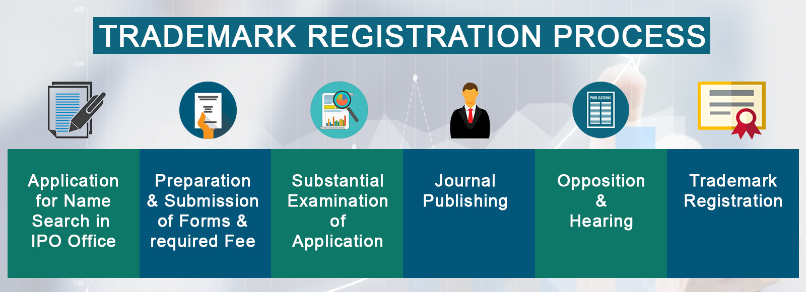
2.3.4 Procedure of Registration of Trademark in India

Slide 39
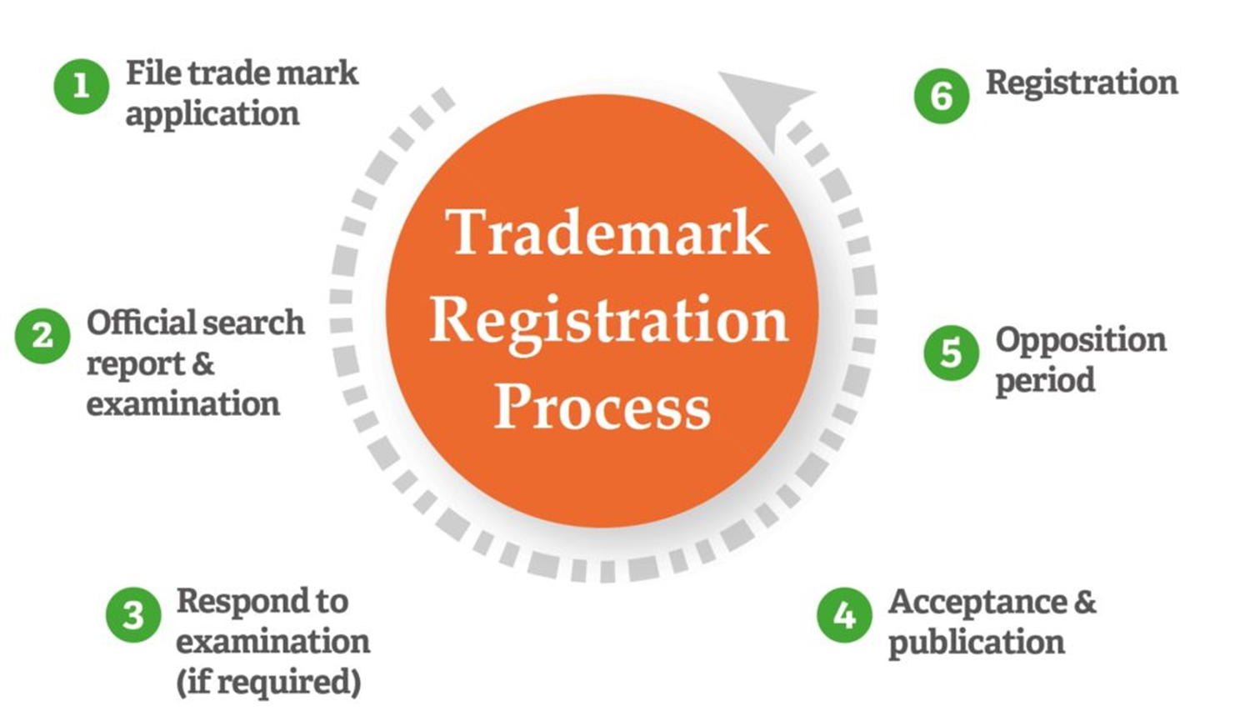
2.3.4 Procedure of Registration of Trademark in India

Slide 40
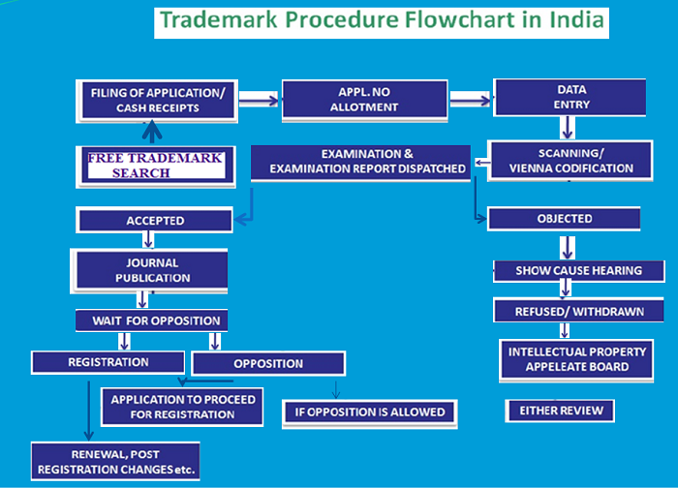

Slide 41
2.3.4 Procedure of Registration of Trademark in India
Convention applications : In order to fulfill the obligations of any treaty, convention or arrangement with a country or countries that are members of inter-governmental organizations, which accord to Indian citizens similar privileges as granted to their own citizens, the Central Government notifies such countries to be Convention Countries.
In case of an application for registration of a trademark made in any of the Convention countries, a priority date can be claimed with regard to the application in India, provided that the application is made within six months of the application having been filed in the Convention country.
The Government has notified and extended this privilege of priority to the members who have ratified the Paris Convention on Protection of Industrial Property.

Slide 42
2.3.4 Procedure of Registration of Trademark in India
Documents needed for trademark registration : An authorization letter that is duly signed by you allows us to file for trademark registration on behalf of you.
After receiving the authorization letter, we start with the preparation of your documents, file the application online and also pay for it. Soon, you receive the confirmation of the application, and you will get the right to use the ™ symbol. While filing for the trademark registration, the documents you need to provide are as follows :
Applicant's name
Business type
Business objectives
Brand/logo/slogan name
Registration address

Slide 43
2.3.4 Procedure of Registration of Trademark in India
Identity and business proofs: The trademark owner or the person who is authorized by the trademark owner needs to submit their identity proof. It can be your Aadhar card, driving license, passport, ration card or voter's id.
Using logo with tagline : If a trademark application is made for a tagline with only words there is no need of a logo. In cases where a logo is used, then it should be submitted in black and white format. The number of words in the logo should exactly be the same as mentioned in the application for a trademark
Form 48 : On behalf of you, an attorney is authorized to file for the trademark application with the trademark registrar. The trademark user affidavit should be submitted in case a claim for the previous trademark was made in the application.

Slide 44
Madrid protocol
The Madrid System is a convenient and cost-effective solution for registering and managing trademarks worldwide. File a single application and pay one set of fees to apply for protection in up to 123 countries. Modify, renew or expand your global trademark portfolio through one centralized system.

Slide 45
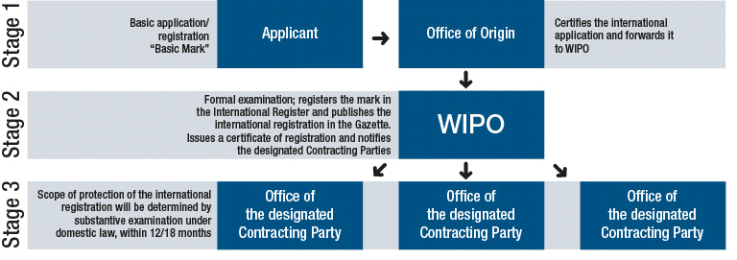
Madrid protocol

Slide 46
2.3.4 Procedure of Registration of Trademark in India
Classification of goods and services: For the purpose of classification of goods and services for registration of trademarks, India follows the International Classification of Goods and Services (Nice Classification) published by World Intellectual Property Organization (WIPO).
For the purpose of classification of the figurative elements of marks, India follows the Vienna Agreement
Opposition proceedings: After advertisement of a trademark in the Trade Marks Journal, (which is available online at the website of Office of Registrar of Trademarks) an opposition challenging the application for registration can be filed by any person within a period of 3 months (which may be extended by a period not exceeding 1 month)

Slide 47
2.3.4 Procedure of Registration of Trademark in India
Renewal of registration: The trademark is initially registered for a period of 10 years, which is calculated from the date of filing of the application and in case of convention application, from the date of priority.
The registration is required to be renewed within 6 months before the date of expiry of the registration, i.e., 10 years from the date of the application or subsequent renewals.
The failure in renewing the trademark within the stipulated period of time and a grace period of maximum 1 year granted for restoration of the trademark, automatically leads to removal of the trademark from the Register of Trademarks

Slide 48
2.3.4 Procedure of Registration of Trademark in India
Rectification of trademark: An aggrieved person may file an application before the registrar of trademarks or to the Intellectual Property Appellate Board (IPAB) for cancellation or varying the registration of the trademark on the ground of any contravention or failure to observe a condition entered on the register in relation thereto.
The application for rectification can also be filed for removal of an entry made in register, without sufficient cause or wrongly remaining on the register and for correction of any error or defect in any entry in the Register

Slide 49
2.4 Meaning and Practical Aspects of Registrations of Patents
2.4.1 Patent Filing
Patent is just like any other intellectual property. It can be transferred or sold by the inventor. A patent is a right granted to an individual or enterprise by the government that excludes others from making, using, selling or importing the patented product or process without prior approval.
Patent filing is the first step an inventor takes to protect his/her invention from being misused.
Patent filing in India is a fairly complicated ordeal, however, with the right legal guidance it can be done easily.

Slide 50
2.4 Meaning and Practical Aspects of Registrations of Patents
2.4.1 Patent Filing
Any business entity or an individual who believes in securing their patent, which is one of the intellectual properties should get legal consultation from expert patent practitioners.
Patent can be filed by any individual or business that wants to protect an invention. An invention can be a new product or a new process
Offices for patent filing in India are spread across major cities like Mumbai, Chennai, Kolkata and Delhi. You need to file your patent at the respective offices in your locality

Slide 51
2.4 Meaning and Practical Aspects of Registrations of Patents
2.4.1 Patent Filing
A PCT (Patent Cooperation Treaty) application can be filed directly to the International Bureau as receiving office.
The application may be filed by mail or hand-delivery to WIPO headquarters, or by facsimile provided that the original of the faxed application is furnished within 14 days from the date of the fax transmission, or by electronic filing (PCT Electronic Filing)
PCT has 153 countries as members

Slide 52
2.4.3 The Process of Acquiring a Patent in India
Invention disclosure
Patentability search
Patent specification preparation
Application preparation and filing

Slide 53
2.4.3 The Process of Acquiring a Patent in India
Invention disclosure
An authorized patent agent provides an invention disclosure format to facilitate inventors to provide relevant information.
The invention disclosure format contains a list of questions arranged in a logical manner to capture the essence and details of the invention required to perform search and prepare patent specification draft.
After reviewing the invention disclosure document, agent requests for one call or face to face meeting with the inventor to ensure that we understand the invention correctly

Slide 54
2.4.3 The Process of Acquiring a Patent in India
Patentability search
Patentability search is not a mandatory step.
In most projects, after receiving the invention disclosure and confirming our understanding with the inventor, agent performs a search and prepare the patentability search report.
Our patentability search report provides information about relevant prior art existing and also provides a rating on the strength of the invention in relation to the closest prior art uncovered.
With the help of the report, one can make an informed decision on whether one would like to go ahead with the next steps in the patent process or not.
The turn-around time for a comprehensive patentability search report is 5-7 working days

Slide 55
2.4.3 The Process of Acquiring a Patent in India
Patent specification preparation
If one choose to go ahead with the patenting process after reviewing the patentability search report, agent start the process of drafting the specification.
The drafting process involves 2 to 3 iterations with the inventor where the analyst seeks clarifications or inputs or review comments from the inventor.
The turn-around time for drafting a specification is about 3 - 4 weeks.
The turn-around time for drafting can vary significantly depending on the availability of the inventors

Slide 56
2.4.3 The Process of Acquiring a Patent in India
Application preparation and filing :
While the drafting process is in progress, our portfolio will be in touch with the inventors and applicants to gather relevant information and signatures.
The portfolio team prepares the application forms and keeps it ready for filing.
Once the drafting process is complete and a specification is ready for filing, portfolio team files the application either using in-house resources or through a partner attorney, depending on the country of interest.
Filing an application after drafting typically takes 1- 3 days.

Slide 57
2.4.3 The Process of Acquiring a Patent in India
Application preparation and filing :
Any patent agent or patent attorney can help you file a patent application in India.
A patent application can be filed by a patent agent, or the applicant or inventor himself.
However, given that most inventors not well versed with the patent laws and procedures, it is always advisable to file a patent application through a registered patent agent or patent attorney with a strong technology background

Slide 58
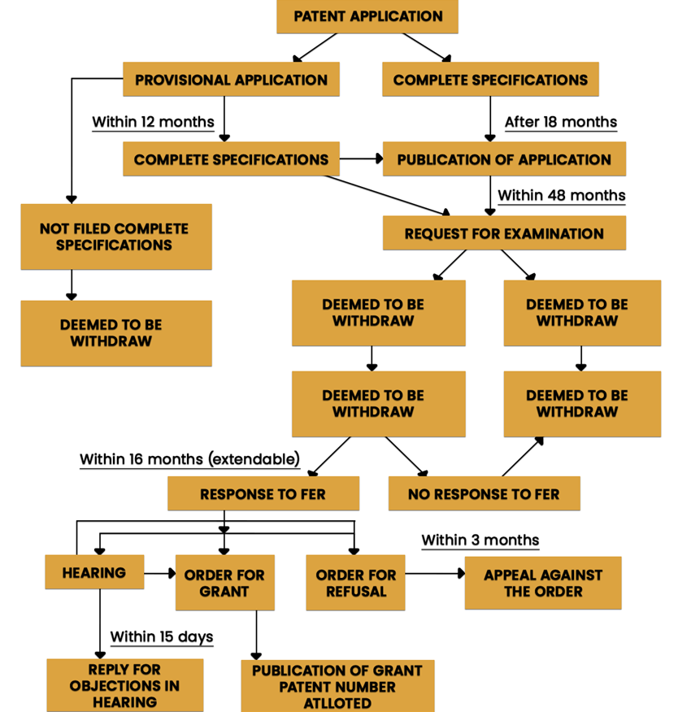
2.4.4 The procedure for the grant of the patent

Slide 59
2.4.4 The procedure for the grant of the patent
Step 1 : Filing a patent application
For patent filing in India, one of the most crucial aspects to consider is the preparation of patent specifications. The entire process of patent specification drafting is a skilled task that can only be done by experienced professionals.
Ideation: Here, you need to clearly pen down the idea or concept, clearly mentioning the key details about the invention and the desired patent.
Visualization : Visualise your idea and elements like diagrams that explain more about the invention.
Verification and Patentability search : The next step is to verify whether your invention is patentable as defined in the Indian Patent Act.

Slide 60
2.4.4 The procedure for the grant of the patent
Step 1 : Filing a patent application
Some inventions may not be patentable, and it is necessary that they meet the patentability requirements such as: Novelty, Nonobviousness, Usefulness and Patentable subject matter. You can also conduct a patent search on
http://ipindiaservices.gov.in/publicsearch with the help of experts.
Drafting a patent application is an art in itself. Seeking the help of a patent professional will be a wise choice here.
If you are in the initial stages of the research and development process, then it is best to file an optional preliminary application called provisional patent application

Slide 61
2.4.4 The procedure for the grant of the patent
Step 2 : Preparation of patentability report
Authorized patent professionals or patent agents will then do an extensive research and prepare the patentability report that contains the analyses based on the above-mentioned criteria.
Why provisional patent application is a good idea before filing the patent application?
A provisional patent application secures your date and work. This means that none of your competitors can file for a similar invention once you file for a provisional patent application.
As India follows the first-to-file system, this ensures that the holder of the provisional patent would also be granted the permanent patent.
There is a buffer time of 12 months to further develop your invention and to specify the complete details

Slide 62
2.4.4 The procedure for the grant of the patent
Step 3: Publication of patent application
The application is then published after 18 months.
A request to the early filing of application can be made along with a prescribed fee
Patent examination :
Would be a formal submission of a request for the patent examination that must be filed within 48 months from first filing the patent (provisional patent or complete patent).
If failed to file within the time frame, per the Patent Act the application will be treated as withdrawn by the patent office.
The examiner then conducts a comprehensive investigation and releases the first examination report called patent prosecution

Slide 63
2.4.4 The procedure for the grant of the patent
Step 3: Publication of patent application
Patent objections:
It is common that patent applicants receive objections, like "inconsistent or unclear claims", "invention lacking novelty", etc. Hence, it is mandatory to analyze the patent examination report and draft a proper response to the objections.
Grant of patent : Once all the patentability requirements are met, the patent grant notification will be published in the patent journal

Slide 64
2.4.4 The procedure for the grant of the patent
Publication of filed patent
For patent filing in India, the Indian patent office keeps every patent application confidential until it gets officially published in the Patent Journal.
The publication of filed patent happens automatically after 18 months from filing the applications, and there is no need of any request to be raised.
To get the patent published in advance, the applicant must initiate a formal request and it will get published within 1 month of the request.
The publication date does matter the most as the inventor is entitled to protect his work legally post publication

Slide 65
PCT International application
If you want to claim your priority in multiple countries, then filing a PCT application is important. It allows filing up to 142 countries.
The time period is 30-31 months from the international filing date to enter and claim protection in each country

Slide 66
2.4.6 A Patent Search
A patentability search report provides comprehensive analysis of relevant prior art and provides analysis on the chances for obtaining patent rights for any given invention.
Using this report, applicants can make an informed choice on going ahead with the patent application process.
Patent search can be performed in free and paid patent databases.
Anyone can search (published and granted) Indian patent documents at official patent database of India as well as other paid databases.
For patent search ,one have to understand patent database search operators and syntax to conduct exhaustive keyword search.
Patent analyst conducts patent search (including keyword and patent classification search) especially in paid databases which may be exhaustive in general, compare to patent search done by yourself in free databases

Slide 67
2.4.6 A Patent Search
Some of the free databases are
google patents (Coverage US, EP, WIPO, CN documents)
freepatentsonline(Coverage US, EP, WIPO, Japan, German documents)
USPTO (US documents)
espacenet (EP documents)
WIPO (PCT documents)
SIPO (Chinese documents)
IPDL (Japanese documents)
Some of the paid databases are,
Totalpatents (Coverage)
Questel Orbit (Coverage)
Relecura
Thomson Innovation

Slide 68
2.4.14 Patent Watch
Patent watch is a process by which issued patents and pending applications are monitored to check if they are of any interest. The interest in watching patents could be related to:
Finding infringement of any rights possessed;
Finding relevant patents for acquisition or licensing;
Finding activities of competitors in the patent space.
The interest in watching patents could be related to :
Finding infringement of any rights possessed;
Finding relevant patents for acquisition or licensing;
Finding activities of competitors in the patent space

Slide 69
2.5 Geographical Indications
In December 1999, the Parliament had passed the Geographical Indications of Goods (Registration and Protection) Act,1999. This Act seeks to provide for the registration and better protection of geographical indications relating to goods in India.
The Geographical Indications Registry would be located at Chennai. The Act has come into force with effect from 15th September 2003
Registration affords better legal protection to facilitate an action for infringement. The registered proprietor and authorised users can initiate infringement actions.
The registration of a geographical indication is valid for a period of 10 years. It can be renewed from time to time for further period of 10 years each.
If a registered geographical indication is not renewed it is liable to be removed from the register.

Slide 70
2.5.2 Benefits of Registration of Geographical Indications
It confers legal protection to Geographical Indications in India.
Prevents unauthorised use of a Registered Geographical Indication by others.
It provides legal protection to Indian Geographical Indications which in turn boost exports.
It promotes economic prosperity of producers of goods produced in a geographical territory.

Slide 71
2.5.4 Applicants for the Registration of a Geographical Indication
Any association of persons, producers, organisation or authority established by or under the law can apply.
The applicant must represent the interest of the producers
The application should be in writing in the prescribed form
The application should be addressed to the Registrar of Geographical Indications along with prescribed fee.

Slide 72
2.5.7 Producer in Relation to a Geographical Indication
The persons dealing with three categories of goods are covered under the term Producer:
Agricultural goods includes the production, processing, trading or dealing
Natural goods includes exploiting, trading or dealing
Handicrafts or Industrial goods includes making, manufacturing, trading or dealing.

Slide 73
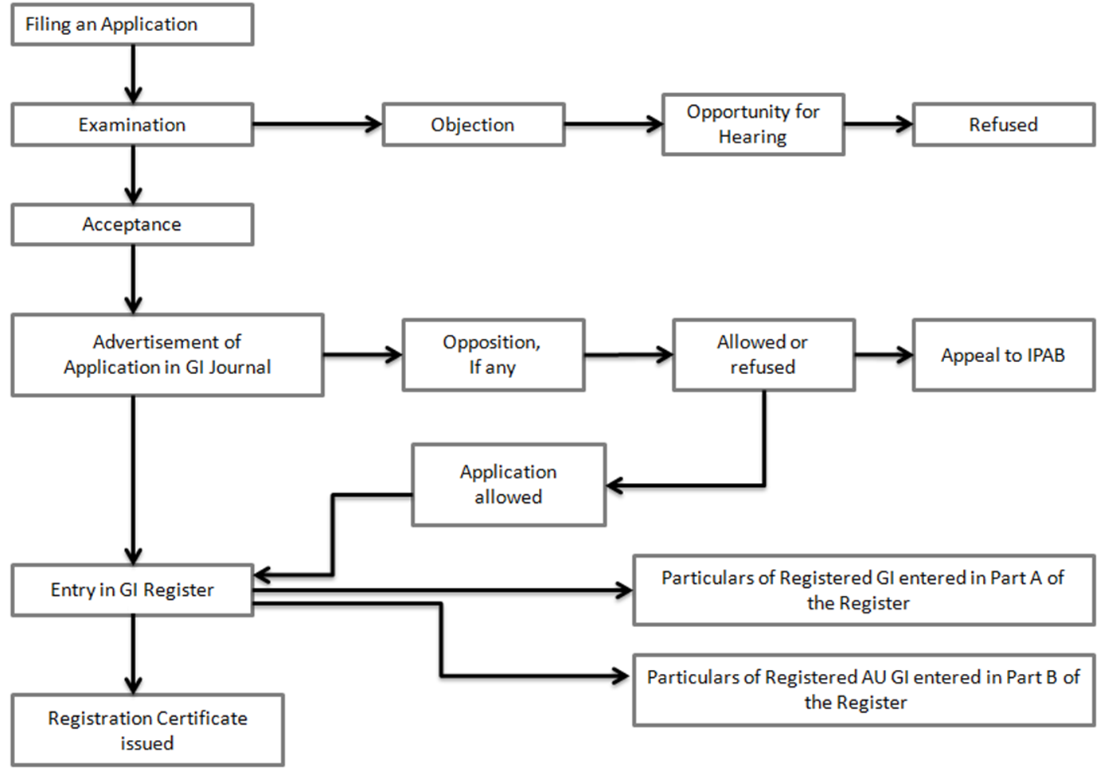
2.5.8 The Registration Process

Slide 74
2.5.8 GI Registration Process
Step 1 : Filing of application
Step 2 and 3 : Preliminary scrutiny and examination
Step 4 : Show cause notice
Step 5 : Publication in the geographical indications journal
Step 6 : Opposition to Registration
Step 7 : Registration
Step 8 : Renewal
Step 9 : Additional protection to notified goods
Step 10 : Appeal

Slide 75
2.6 Trade Secrets
The benchmark/reputation/success of a company hinges on their unique product and service offering, as it differentiates it from the rest to occupy a unique niche in the marketplace.
Naturally, no company would like competitors to find out how it does things and dilute its competitive edge; these are its 'trade secrets.’
Trade secrets can protect a company’s confidential business information. This information usually distinguishes a company and sets it apart from rivals.
A trade secret is a type of intellectual property in the form of a formula, practice, process, design, instrument, pattern, commercial method, or compilation of information that is not generally known or reasonably ascertainable by others, and by which a person or company can obtain an economic advantage over competitors.

Slide 76
2.6.2 Types of Trade Secrets
The ingredients used in the product :
For example, soft drinks manufacturer Coca-Cola keeps its ingredients a closely-guarded secret and the recipe is accessible only to a select few.
Way of manufacturing :
A company may get a competitive edge just by finding a new way of making things. These may include types of manufacturing equipment, processes or systems.
Way of selling and distribution :
Companies often devise unique methods of selling and distributing products, which may give them an extra edge.
India does not have a specific codified legislation to protect Trade Secrets.

Slide 77
2.7 Registration of Industrial Designs in India and Abroad
Design is a right created by the statue which is different from Trade Mark and Copyright.
In terms of Design Act, 2000, design means only the features of shape, configuration, pattern, ornament or composition of lines or colors applied to any article whether in two dimensional or three dimensional or in both forms, which in the finished article appeal to and are judged solely by the eye.
Design is one of the categories of IPR where the design system focuses on the aesthetic feature of an article derived from its visual appearance.
Relevant aspects are the shape, configuration, surface pattern, the colour or line or a combination thereof as applied to an article which produces an aesthetic impression on the sense of sight.

Slide 78
2.7.2 Criteria of Design Registration
Design should be new or original.
It should not be published in any country.
Not contrary to public order or morality.
Should not attract the provision of section 4 of Designs Act,2000
Prohibition of registration of certain designs : A design shall not be registered if the design:
Is not new or original; or
Has been disclosed to the public :
Any where in India or in any other country by publication in tangible form or by use or in any other way prior to the filing date, or where applicable, the priority date of the application for registration; or
Is not significantly distinguishable from, known designs or combination of known designs; or
Comprises or contains scandalous or obscene matter.
Designs incorporating official symbols or emblems, maps, buildings, stamps, medals etc. cannot be registered under The Designs Act, 2000

Slide 79
2.7.7 Steps to Register a Design
Name and address of the Applicant;
Legal Status of the Applicant i.e. whether the applicant is natural person, Company etc. If the Applicant claims to be a start-up (registered with the Government of India as a start-up), the certificate has to be filed.
Description of article to be filled in along with identification of the class as per the classification.
The nature of applicant determines the official fee for the application.
The image or drawing of the article is to be filed along with the application.
Claim of novelty is to be made in the application i.e. whether any part of the article or the entire article is novel.
The government fees for filing a design application for a natural person and start up is half of that of an artificial person like a Company.
In order to encourage online filing, law provides for a 10 % discount for online filing vis-à-vis paper filing at Design office

Slide 80
